Slide 1

A Local Cafe app with Order Tracking feature
Sanam Permeh

Slide 2
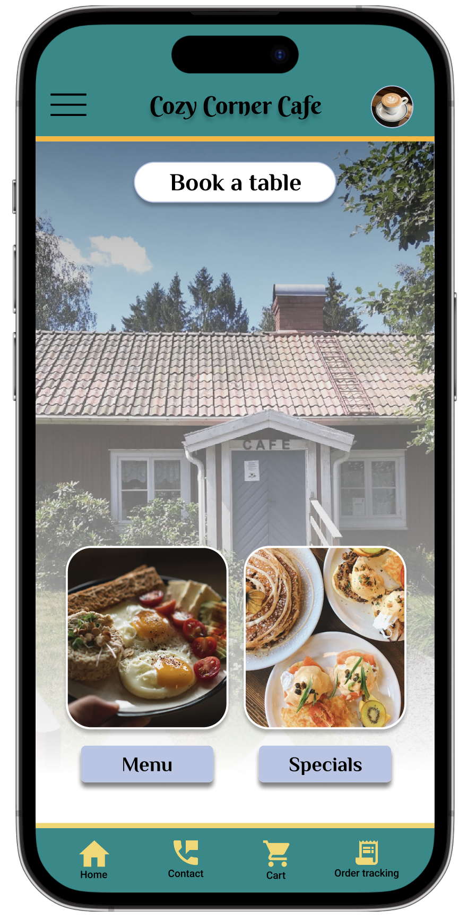
Project overview
The product:
Cozy Corner Cafe is a regional cafe located in the suburbs of a metropolitan area. Cozy Corner Cafe strives to deliver healthy, specialty cafe style dishes and drinks. They offer a wide spectrum of competitive pricing. Cozy Corner Cafe targets customers like commuters and workers who lack the time or ability to prepare a family meal.
Project duration:
November 2022 to February 2023.

Slide 3
Project overview
The problem:
Busy workers lack the time necessary to prepare a meal or have their own packed lunchbox. They need to order their food online and need to know the accurate timing for pick up or delivery.
The goal:
Design an app for Cozy Corner Cafe that allows users to easily order and pick up or have their warm, fresh, healthy dishes or drinks on time by being able to track their orders.

Slide 4
Project overview
My role:
UX designer designing an app for Cozy Corner Cafe from conception to delivery.
Responsibilities:
Conducting interviews, paper and digital wireframing, low and high-fidelity prototyping, conducting usability studies, accounting for accessibility, and iterating on designs.

Slide 5
User research
Personas
Problem statements
User journey maps
Understanding
the user

Slide 6
User research: summary
I conducted interviews and created empathy maps to understand the users I’m designing for and their needs. A primary user group identified through research was working adults who don’t have time to cook meals.
This user group confirmed initial assumptions about Cozy Corner Cafe customers, but research also revealed that busy workers need to know the pick up or delivery time as it usually happens that they go to pick up their order but it is not ready and they do not have time to stay there, or they are late and their order is not cold or warm enough anymore.

Slide 7
User research: pain points
1
2
3
4
Time
Order tracking
IA
Favourite order
Working adults are too busy to spend time on meal prep
Users need to know the timing for their order pick up or delivery.
Text-heavy menus in apps are often difficult to read and order from
Users need to save their favourite order to save time for next online ordering.

Slide 8
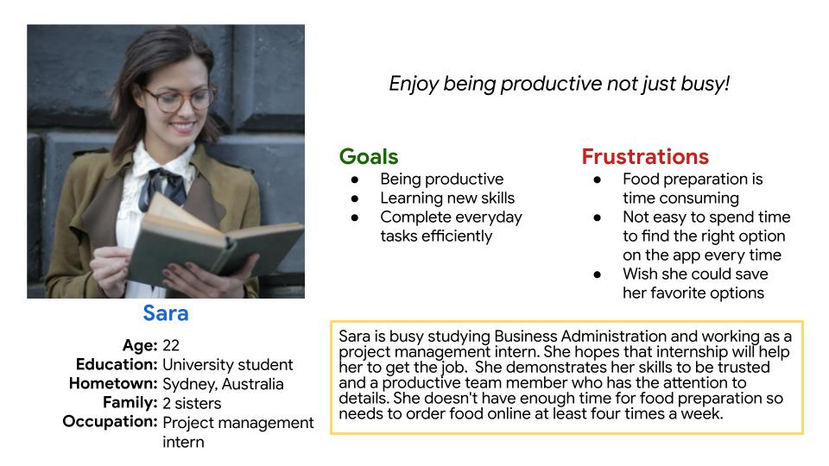
Persona: Sara
Problem statement:
Sara is a project management intern and a student who needs to have an option in the app to save her favourite items
because she does not have enough time to browse through the menu every time.
.

Slide 9
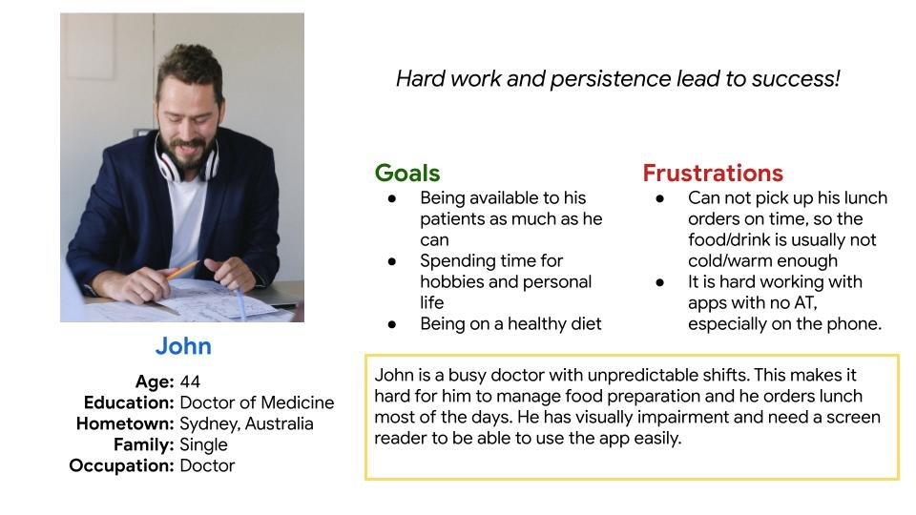
Persona: Name
Problem statement:
John is a busy doctor
who needs a feature in the app to keep his order track because he does not know when his order is ready to pick up and sometimes he gets there early, so the order is not ready and sometimes late so the order is cold.
.

Slide 10
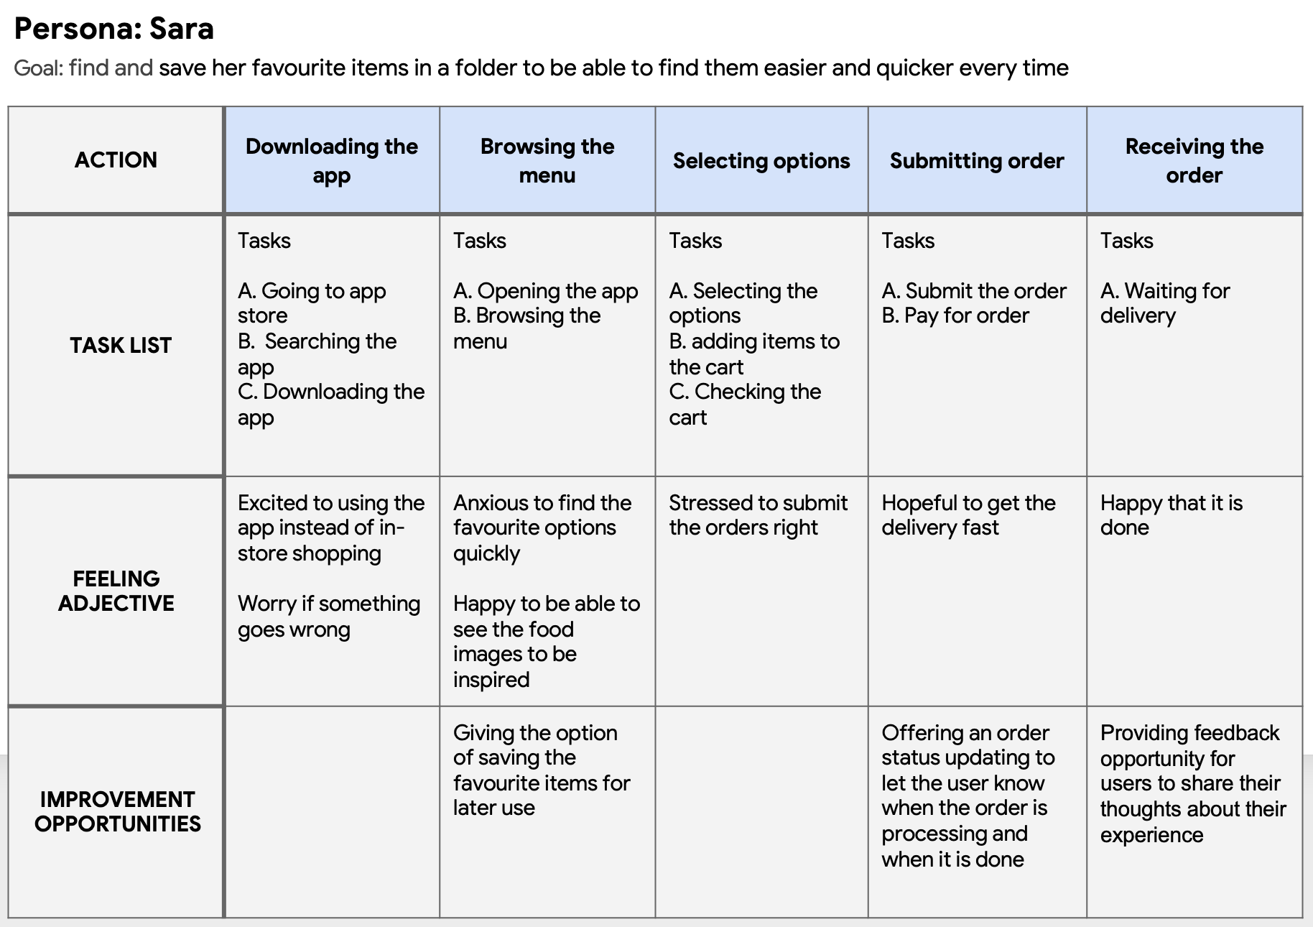
User journey map
Mapping Sara’s user journey revealed how helpful it would be for users to have access to order tracking option and saving favourite orders for later online orders.

Slide 11
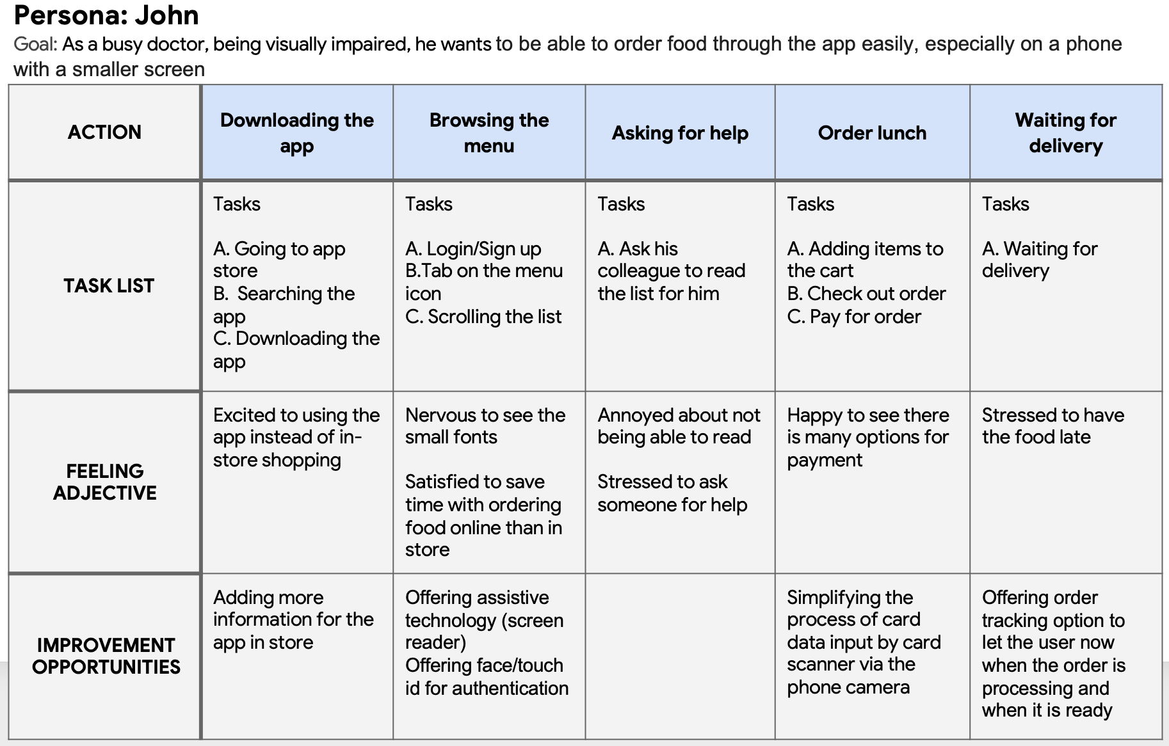
User journey map
Mapping John’s user journey revealed how helpful it would be for users to have access to a order tracking option and considering accessibility in designing the app.

Slide 12
Paper wireframes
Digital wireframes
Low-fidelity prototype
Usability studies
Starting
the design

Slide 13
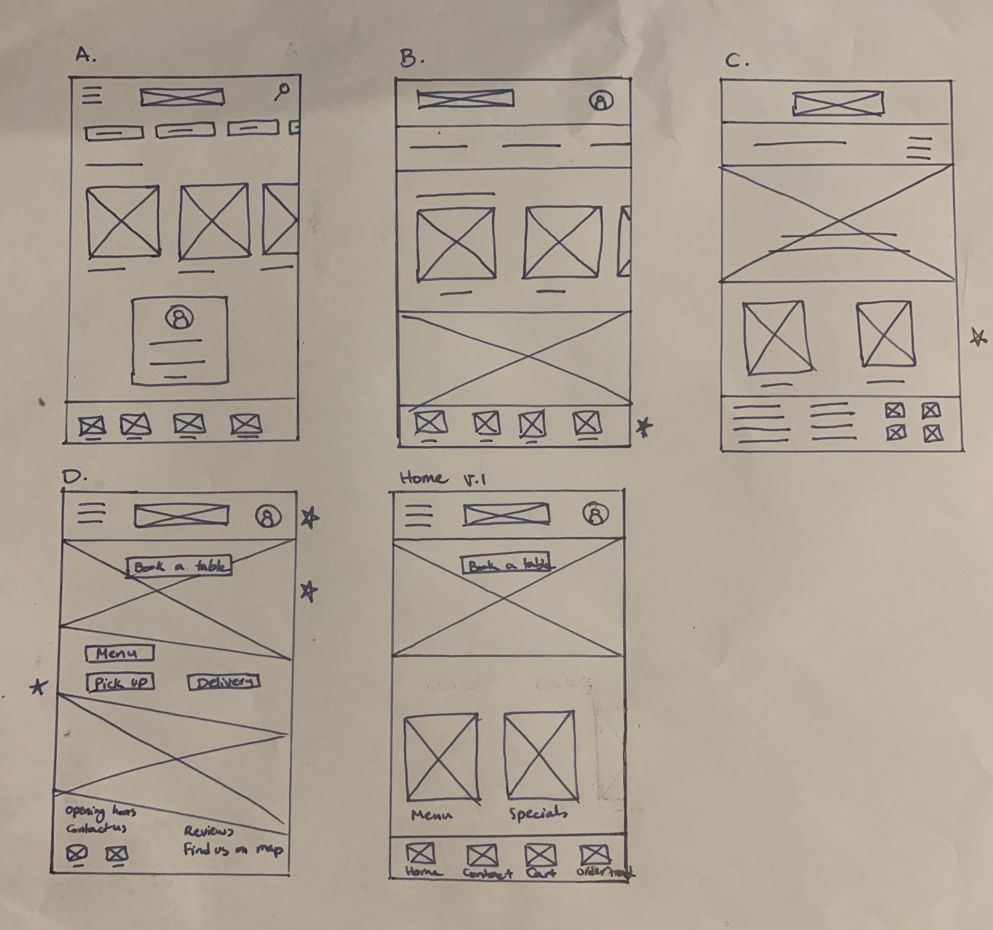
Paper wireframes
Taking the time to draft iterations of each screen of the app on paper ensured that the elements that made it to digital wireframes would be well-suited to address user pain points. For the home screen, I prioritized a quick and easy order tracking process icon as well as access through the profile icon and hamburger menu, to help users save time.
Stars were used to mark the elements of each sketch that would be used in the initial digital wireframes.

Slide 14
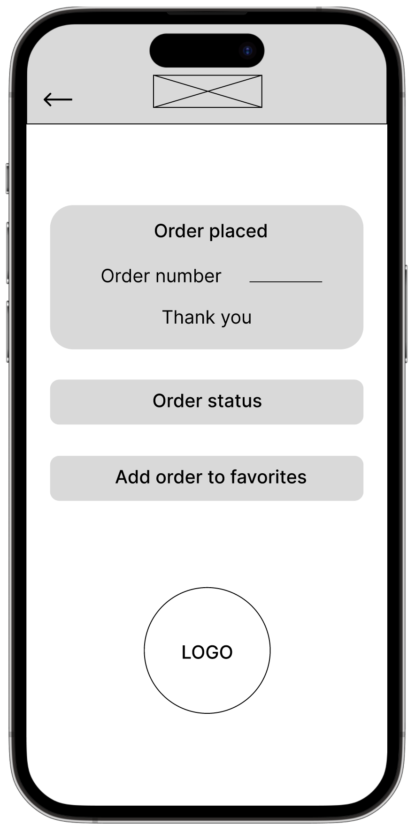
Digital wireframes
As the initial design phase continued, I made sure to base screen designs on feedback and findings from the user research.
This button in the order placing confirmation page, let the users to track their order to estimate the pick up/delivery time more accurately.
This button allows users to add the order to their favourites, so they save time in later returns to the app

Slide 15
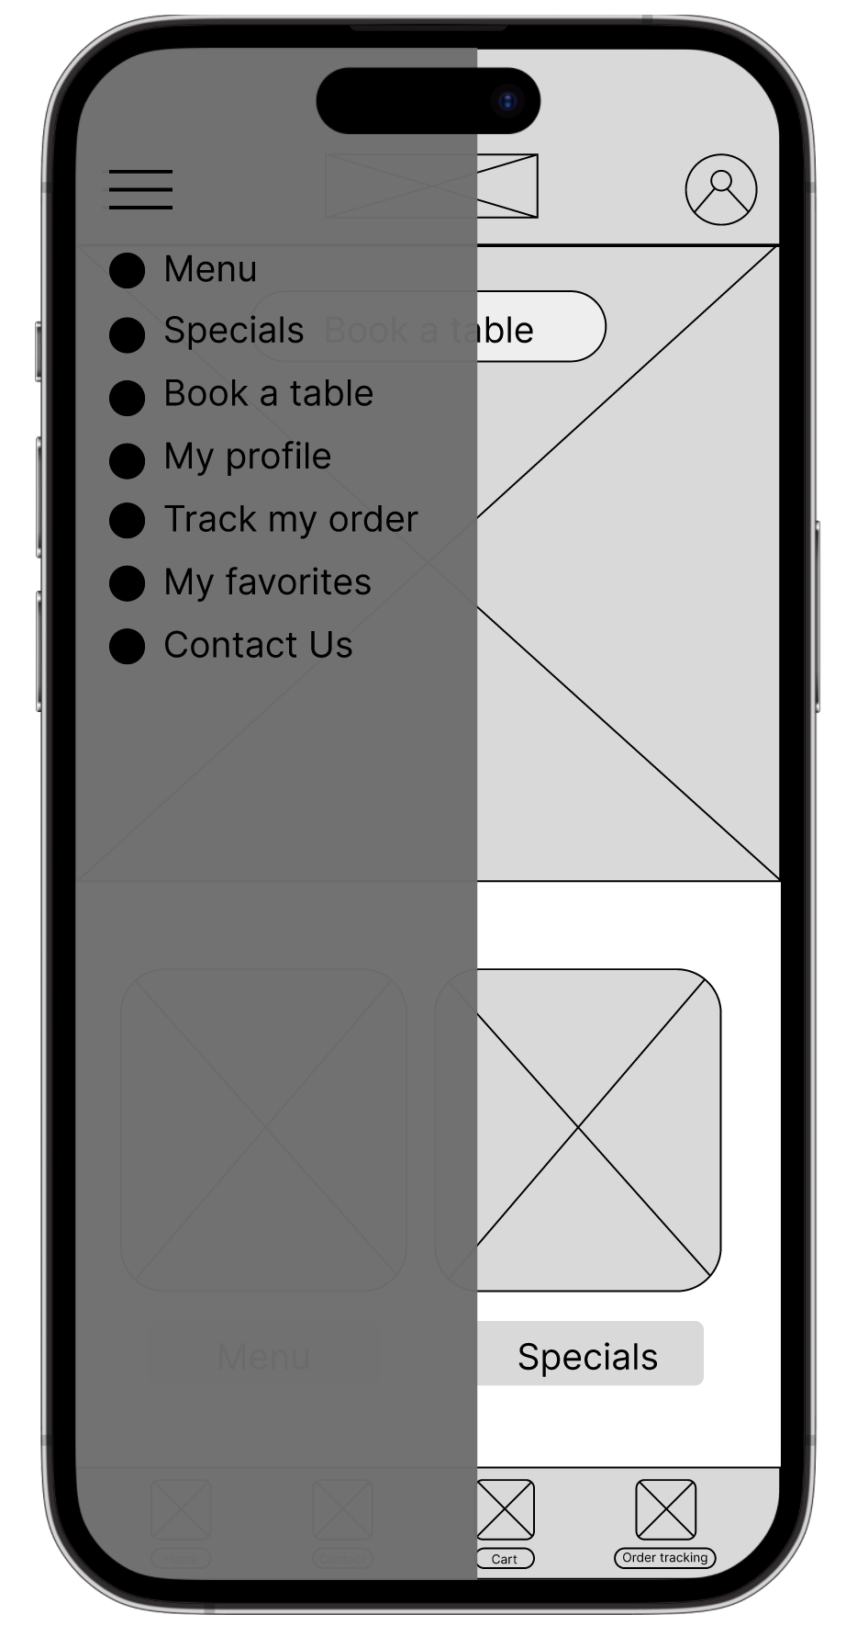
Digital wireframes
Icon and text to match accessibility guidelines.
Easy navigation was a key user need to address in the designs in addition to equipping the app by using the icon along with text to adjust it with accessibility guidelines.
Another Access to order tracking process for users to prefer using the hamburger menu.

Slide 16
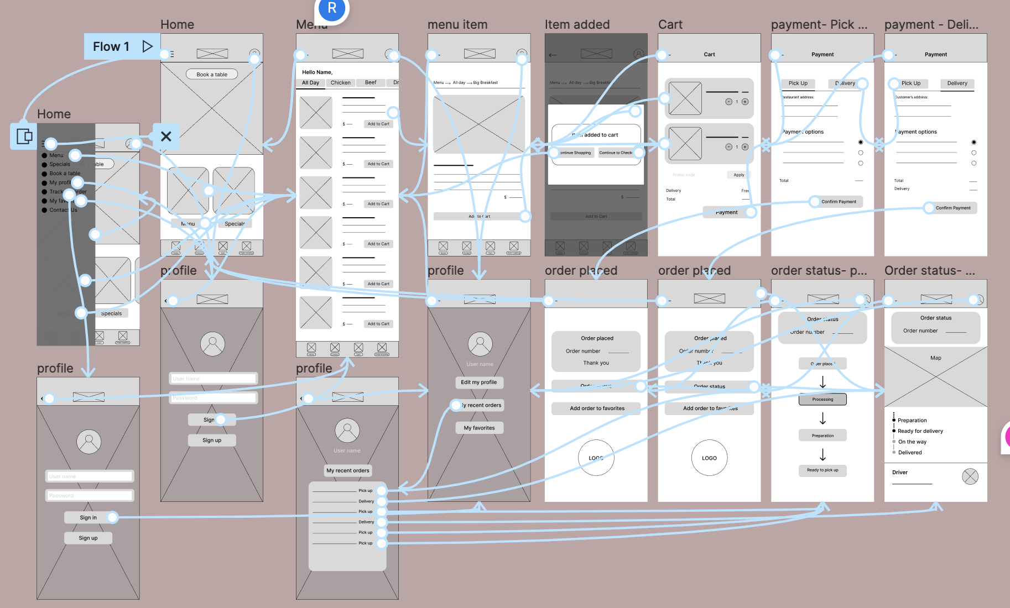
Low-fidelity prototype
Using the completed set of digital wireframes, I created a low-fidelity prototype. The primary user flow I connected was ordering a cafe food or drink and the order tracking feature, so the prototype could be used in a usability study. I added more pages to the app after the first usability study.

Slide 17
Usability study: findings
I conducted two rounds of usability studies. Findings from the first study helped guide the designs from wireframes to mockups. The second study used the high-fidelity prototype and revealed what aspects of the mockups needed refining.
Round 1 findings
Round 2 findings
Users need to first decide about the delivery option, then see that in the last stage of the check out.
1
1
Users need a clearer way to see their options for order tracking.
Users need a confirmation email to be able to check their delivery status without the need to login to the app constantly.
Users need a remove or cancel button for each added item to the cart to be able to edit their cart.
2
2
3
Users need a quantity option added to the item’s page.

Slide 18
Refining
the design
Mockups
High-fidelity prototype
Accessibility

Slide 19
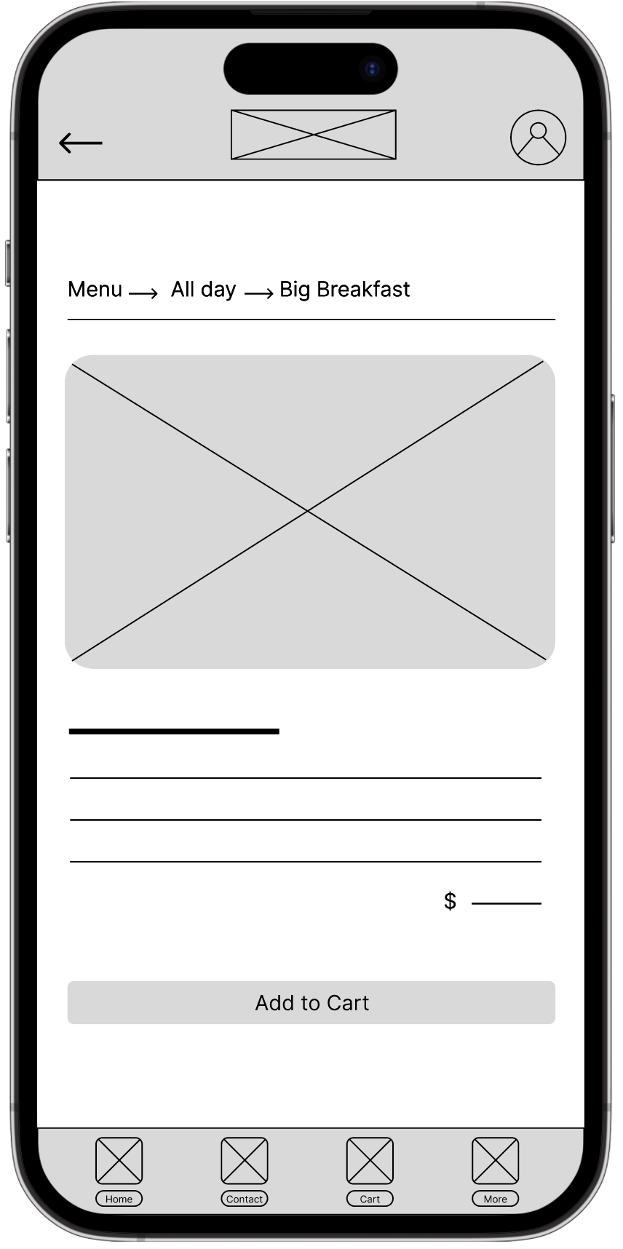
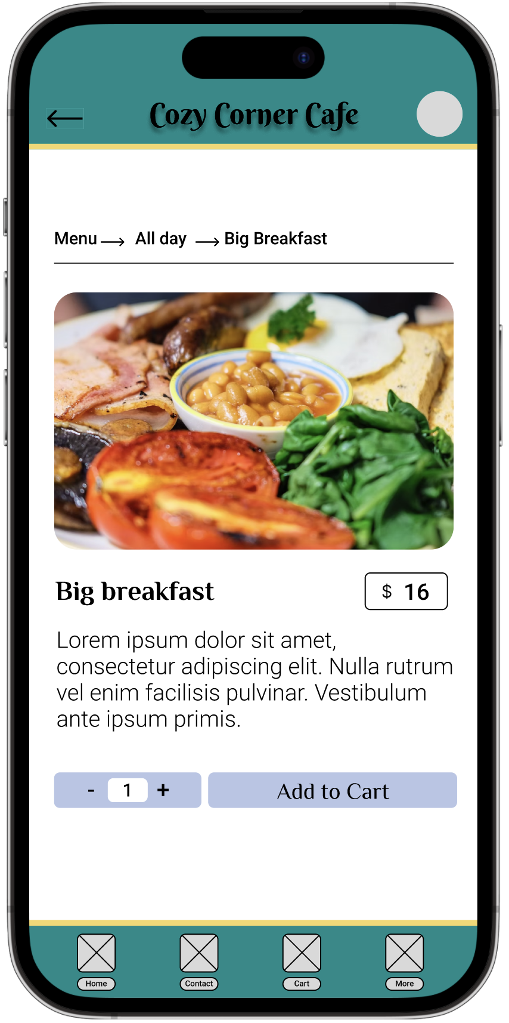
Mockups
Before usability study
After usability study
Early designs, allowed users to add one item at a time to their cart. After usability study, I added item quantity input option to the item’s page.

Slide 20
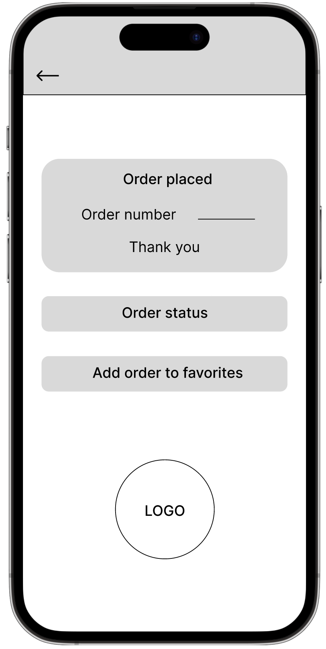
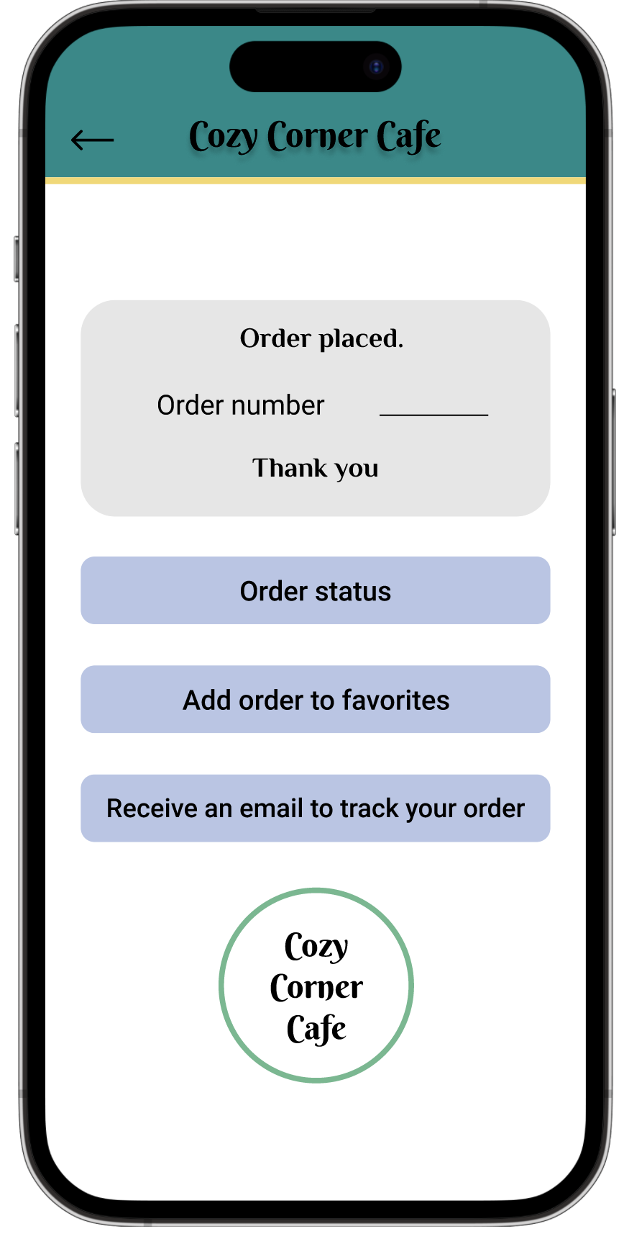
Mockups
Before usability study
After usability study
In the order placing confirmation page, users had the option to either go to order status page or add the order to their favorites page. After usability study, I added the option to receive the confirmation email as well to make the order tracking process easier.

Slide 21
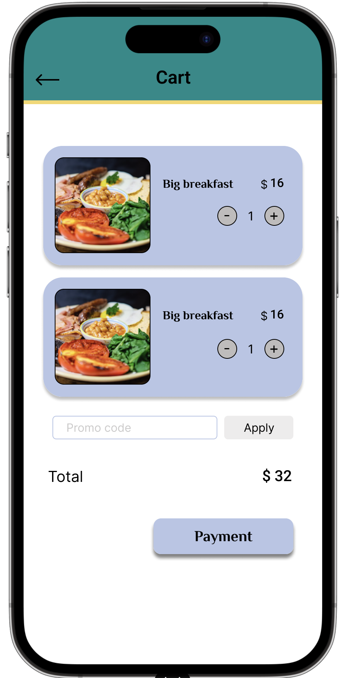
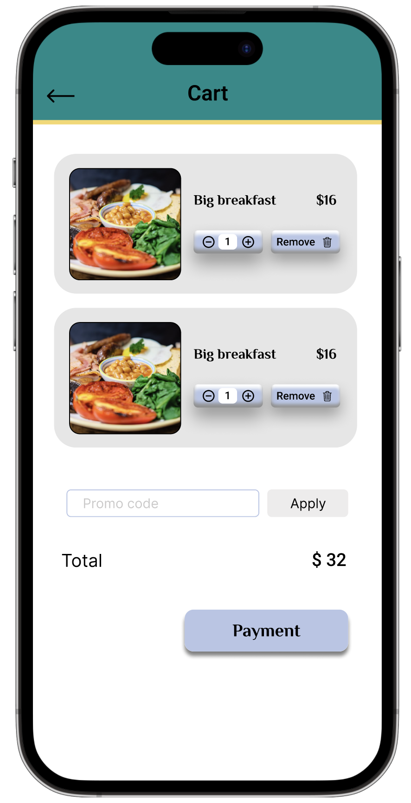
Mockups
Before usability study
After usability study
The second usability study revealed frustration with the cart item’s editing, if there was a need to remove an item. After the usability study, I added the “remove” button and changed the quantity input button design to match the remove button.

Slide 22
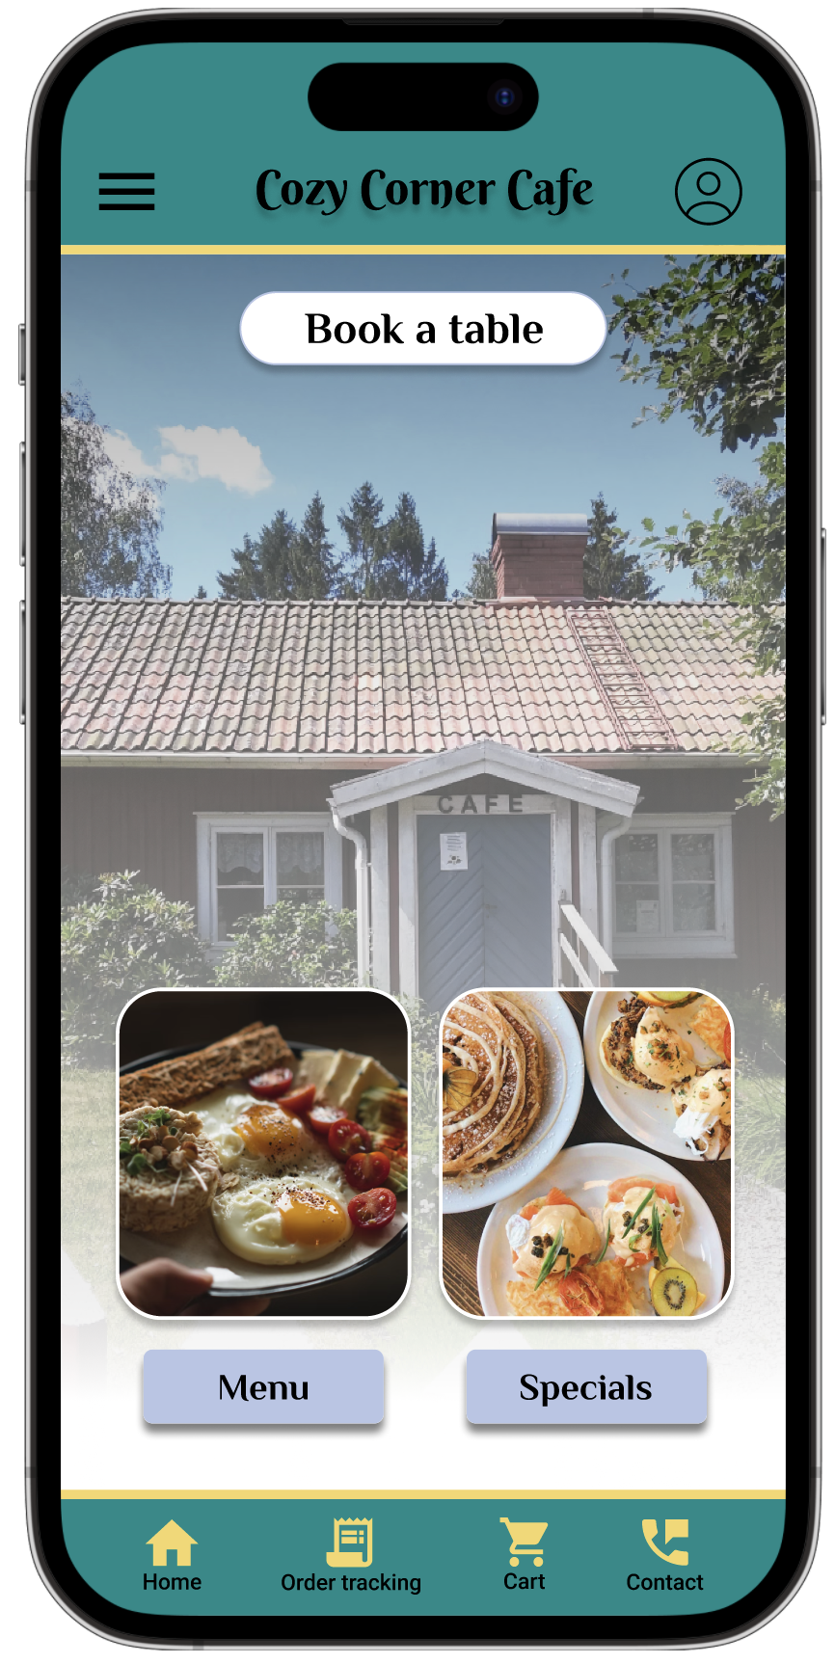
Mockups
Before usability study
After usability study
There are three ways to track an order in the app. One of the ways is through the order tracking icon in the footer area. After usability testing, I relocated the icon to the second place and increased the font and icon size to make it easier to be seen.

Slide 23
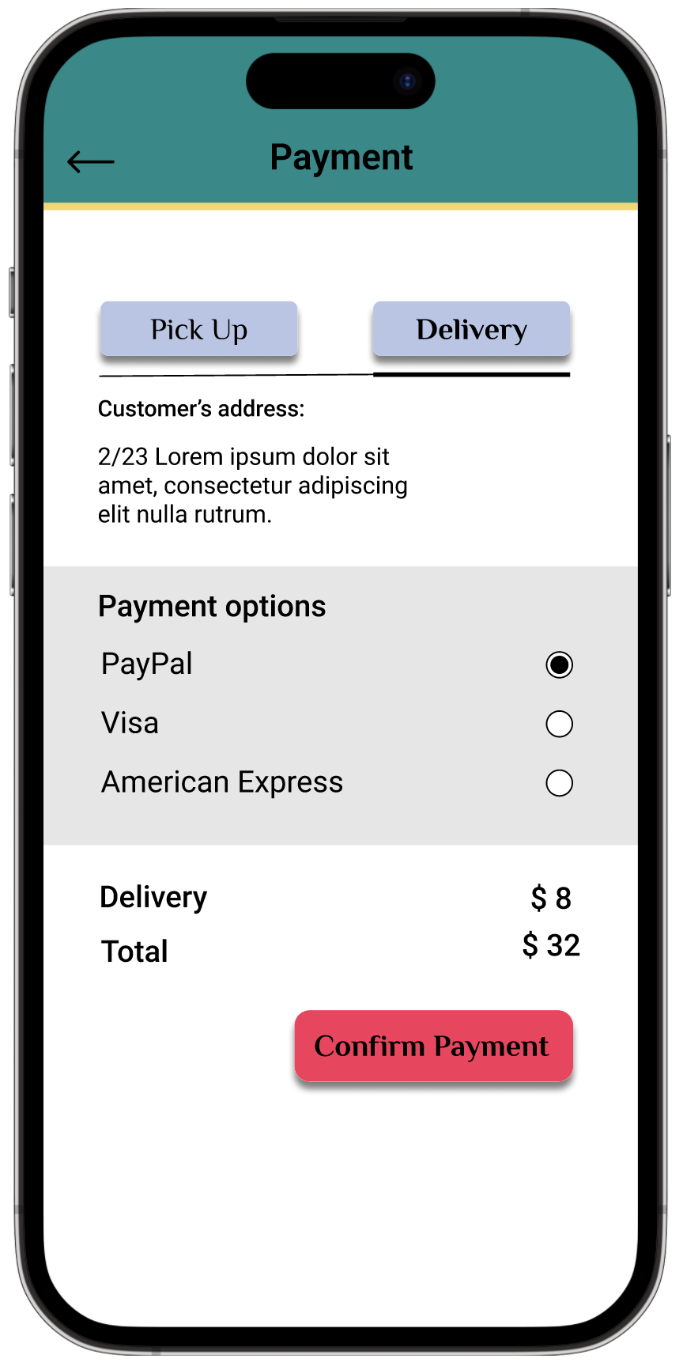
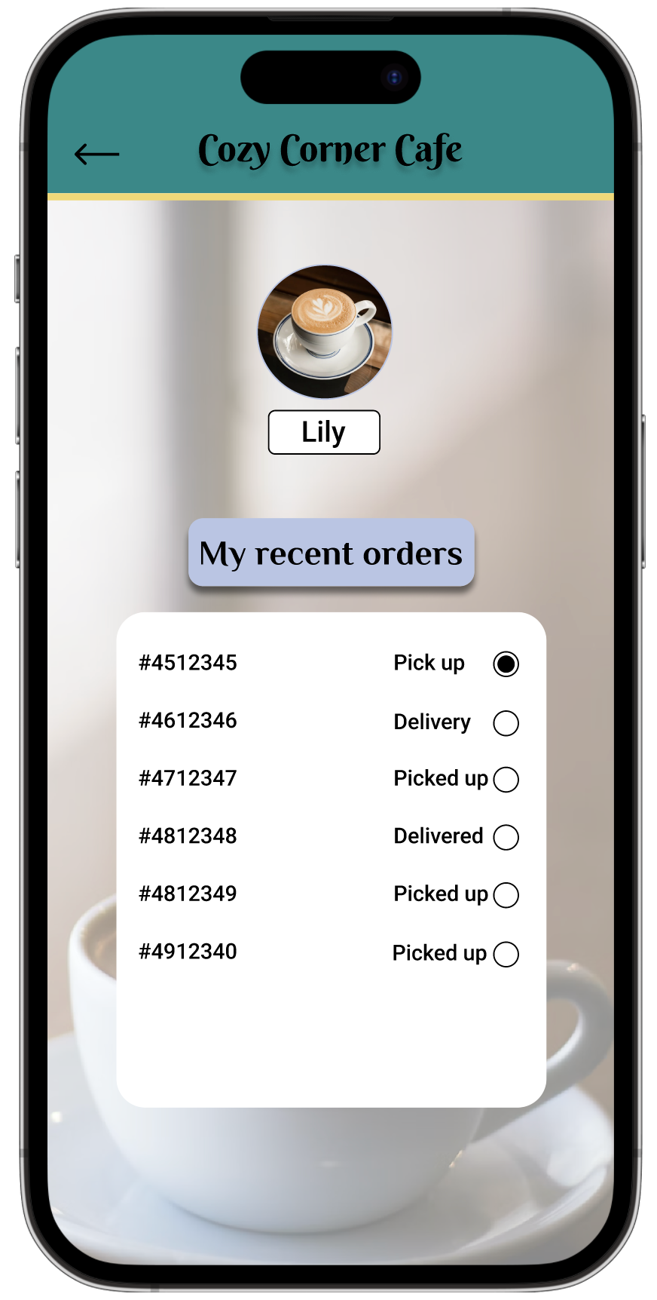
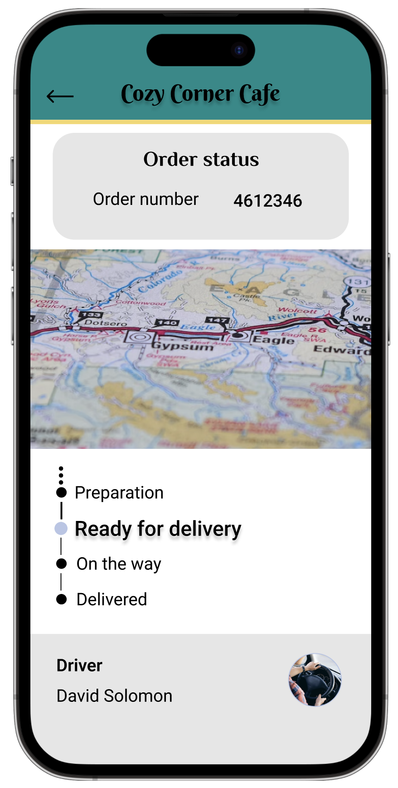
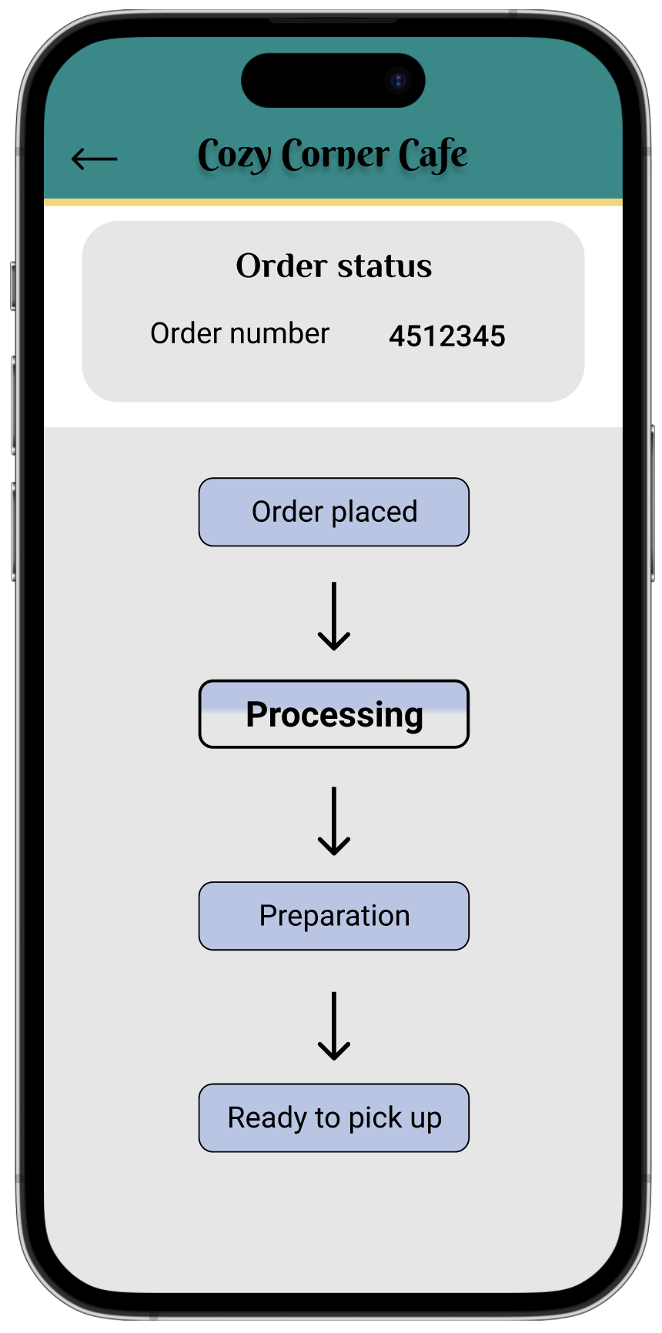
Mockups

Slide 24
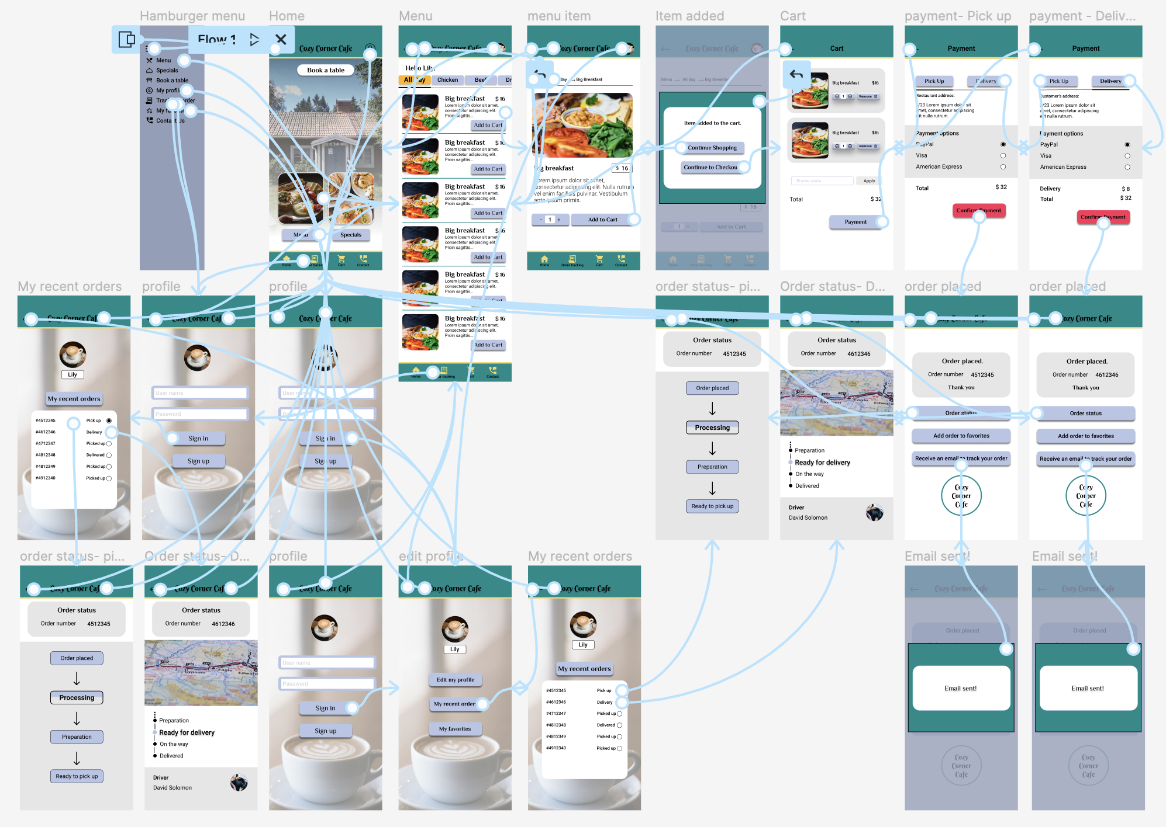
High-fidelity prototype
The final high-fidelity prototype presented cleaner user flows for food ordering and tracking the orders. It also met user needs for order tracking, confirmation email and cart editing.
View the Cozy Corner Cafe app: Cozy Corner Cafe hi-fi Prototype

Slide 25
Accessibility considerations
1
2
Based on WCAG (Web Content Accessibility Guidelines), I used icons with text together to make it more accessible for those with accessibility needs.
I have also checked the colour contrast for the background, text and buttons throughout the app to make sure everything is following the guidelines for accessibility purposes.

Slide 26
Going forward
Takeaways
Next steps

Slide 27
Takeaways
Impact:
The app makes users feel like Cozy Corner Cafe really thinks about how to meet their needs.
One quote from peer feedback:
“The app made it so easy to order my own food and track my order! I would definitely use this app as a go-to for a delicious, fast, and even healthy meal.”
What I learned:
While designing the Cozy Corner Cafe app, I learned that the first ideas for the app are only the beginning of the process. Usability studies and peer feedback influenced each iteration of the app’s designs.

Slide 28
Next steps
1
2
Conduct another round of usability studies to validate whether the pain points users experienced have been effectively addressed.
Conduct more user research to determine any new areas of need.

Slide 29
Let’s connect!
Thank you for your time reviewing my work on the Cozy Corner Cafe app! If you’d like to see more or get in touch, my contact information is provided below.
Email: sanam.permeh@gmail.com
Website: https://sanampermehbc10.myportfolio.com/

